Slide 1
Emotion Detection From Tweets And Emoticons
Made by-
Jain Rajat Ashok(22)
Dubey Arun Kumar Vyas (14)
Kshatriya Sawan Ranjan(32)
Shukla Pratyush Suresh(58)

Slide 2
What is Sentiment Analysis?
It is classification of the polarity of a given text in the document, sentence or phrase
The goal is to determine whether the expressed opinion in the text is positive, negative or neutral

Slide 3

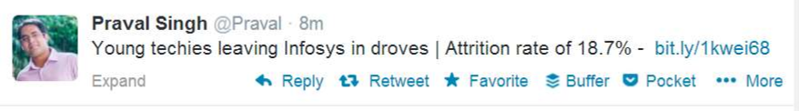
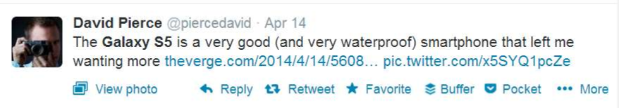


Slide 4
Why is Sentiment Analysis Important?
Micro blogging has become popular communication tool
Opinion of the mass is important
- Political party may want to know whether people support their program or not.
- Before investing into a company, one can leverage the sentiment of the people for the company to find out where it stands.
- A company might want find out the reviews of its products

Slide 5
Using Twitter for Sentiment Analysis
Popular micro blogging site
Short Text Messages of 140 characters
240+ million active users
500 million tweets are generated everyday
Twitter audience varies from common man to celebrities
Users often discuss current affairs and share personal views on various subjects
Tweets are small in length and hence unambiguous.

Slide 6
Problem Statement
The problem at hand consists of two subtasks:
• Sentence Level Sentiment Analysis in Twitter:
Given a message, decide whether the message is of positive or negative sentiment.
For messages conveying both a positive and negative sentiment, whichever is the stronger sentiment should be chosen.
•Emoticons Level Sentiment Analysis in Twitter:
Given a emoticon whether that instance is positive, negative in that context.

Slide 7
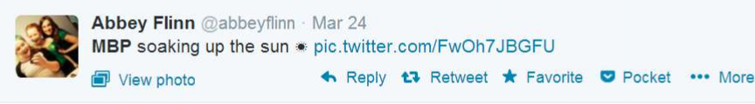
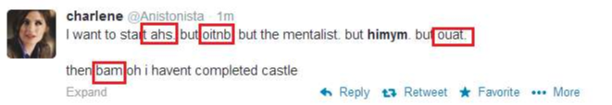
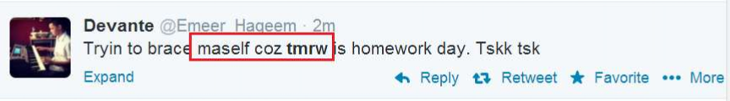
Challenges
• Tweets are highly unstructured and also non-grammatical
• Out of Vocabulary Words
• Lexical Variation

Slide 8
Approach
Tweet Downloader
Tokenization
Preprocessing
Feature Extractor and Algorithm
Classification into positive, negative

Slide 9
Approach
Tweet Downloader
Download the tweets using Twitter API
Tokenization
Tokenization is the act of breaking up a sequence of strings into pieces such as words, keywords, phrases, symbols and other elements called tokens
Preprocessing
Removing non-English Tweets
Replacing Emoticons by their polarity
Remove URL, Target Mentions, Hashtags, Numbers.
Replace Negative Mentions
Replace Sequence of Repeated Characters e.g. ‘coooooooool’ by ‘cool’
Remove Nouns and Prepositions

Slide 10
Feature Extractor
Percentage of Capitalized Words
Number of Positive/Negative Hashtags
Number of Positive/Negative/Extremely Positive/Extremely Negative Emoticons
Number of Negation
Number of special characters : ?,!,*
Algorithm and Prediction
The features extracted are next passed on to decision tree and ANN .
The model built is used to predict the sentiment of the new tweets.

Slide 11
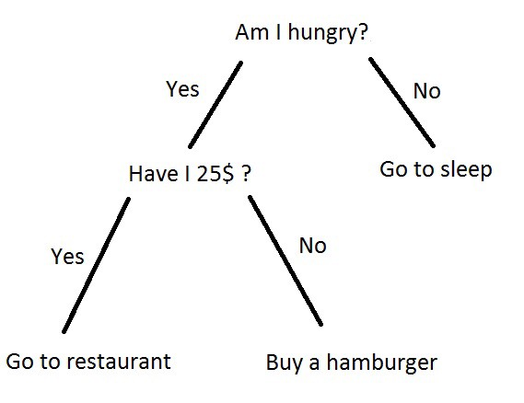
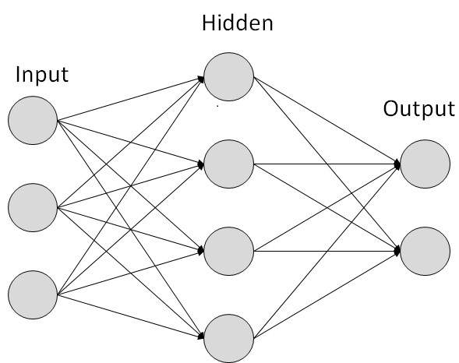
Algorithms Used
A decision tree is a decision support tool that uses a tree-like graph or model of decisions and their possible consequences, including chance event outcomes, resource costs, and utility. It is one way to display an algorithm that only contains conditional control statements.
An Artificial Neural Network (ANN) is a computational model. It is based on the structure and functions of biological neural networks. It works like the way human brain processes information. It includes a large number of connected processing units that work together to process information

Slide 12
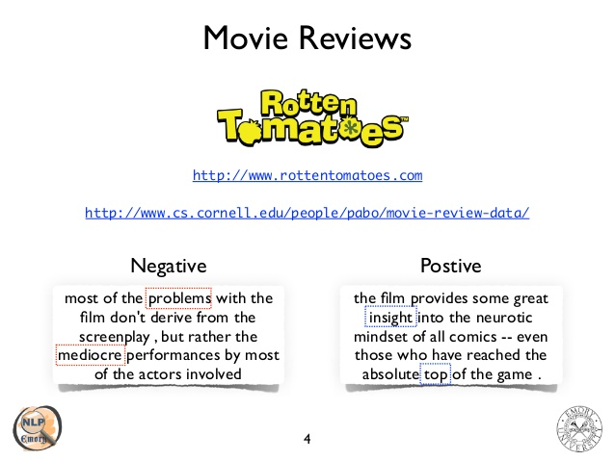
Applications
Used in Movie reviews

Slide 13
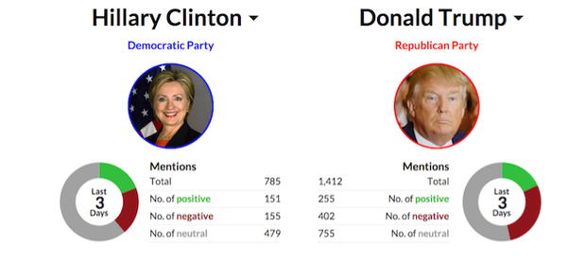
Knowing public opinion for political leader or their notions about rules and regulations

Slide 14
Future Work
Using different other models and algorithms.
Temporal analysis can be added as a future work in the project.
Consideration of Retweets as a factor.

Slide 15


